Slide 1
SAP BTP Extension Suite Training
Day 2
Anubhav Oberoy
www.AnubhavTrainings.com
Follow excellence with sheer passion

Slide 2


DISCLAIMER
The training content and delivery of this presentation is confidential, and cannot be recorded, or copied and distributed to any third party, without the written consent of Anubhav Trainings

Slide 3

Introduction
Welcome to the BTP Architect Training Course, specially designed for senior SAP Consultants planning to provide guidance on SAP BTP Adoption
The Course is designed to provide end to end development on SAP Business Technology platform, Deployment, lifecycle and security overview with Hands-on
Notes:
https://pixabay.com/photos/architecture-building-amsterdam-1448221/

Slide 4
Agenda
01
Environments, Subscriptions, and Services
02
BTP Use cases
03
Micro service architecture and First Micro service in SAP BTP

Slide 5
Environments, Subs, and services
Environments
Environments constitute the actual platform-as-a-service offering of SAP BTP that allows for the development and administration of business applications. Environments are anchored in SAP BTP on subaccount level.
SAP BTP offers three environments: ABAP, Cloud Foundry and Kyma. Some existing customers still have Neo, but this is no longer offered.
Subscription based services
You will also see these ones called software as a service (SaaS), or multitenant applications. The experience here is that you subscribe to the service, and in return you receive a URL, from which you can access that service. Opening the URL brings you to a web application from which you can leverage the service. This is how other SaaS like SuccessFactors or S/4HANA Cloud work as well. They are also enabled at a subaccount level, and are independent of the environments. You don’t need to have Cloud Foundry enabled to subscribe to SAP Launchpad Service, for example.
Examples include Launchpad, SAP Business Application Studio, Cloud Integration, Process Automation…
Instance based services
These are the purest services. They provide a specific functionality, like databases, connectivity, authentication…. You connect your application to them to leverage that functionality. These services don’t provide a UI to manage them. Instead, they rely on API to connect to applications and other services and provide their services. They are provisioned inside an environment, so they are environment specific. Each environment has its own organization (for users and applications): In Cloud Foundry, instances are created inside a space. For Kyma, instances are created inside a namespace.

Slide 6
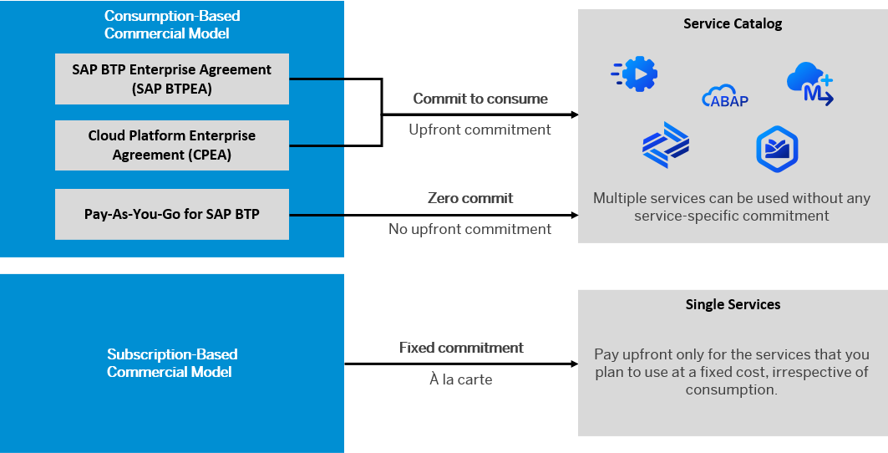
BTP Subscription Models
https://help.sap.com/docs/btp/sap-business-technology-platform

Slide 7
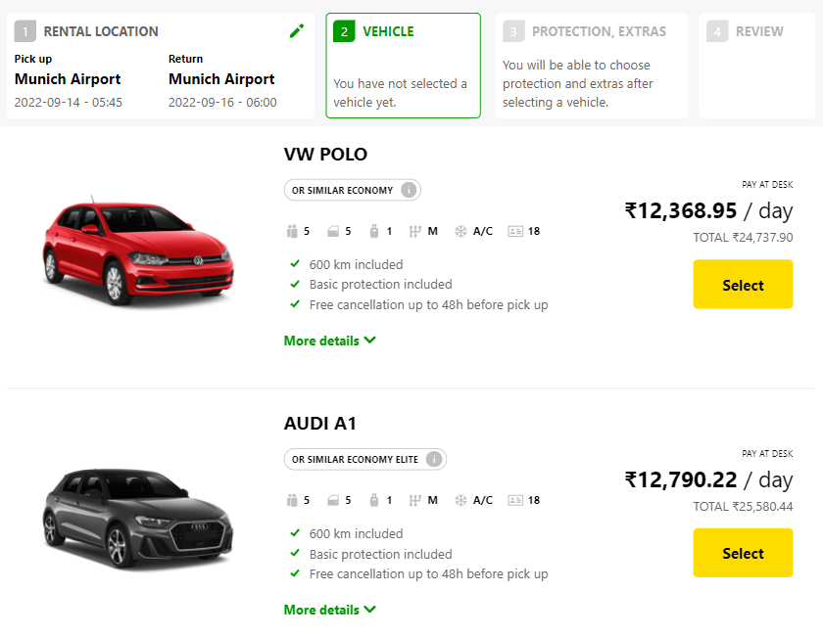
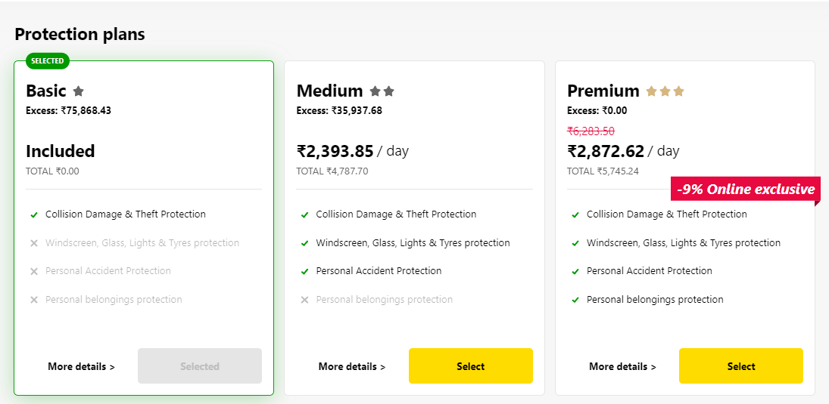
Backing Services in BTP
Each service has one or more service plans available. A service plan is the representation of the costs and benefits for a given variant of a particular service. For instance, a database may be configured with various "T-shirt sizes", each of which is a different service plan.
Choose Your service
Backing Service
Select Plan
Service Plan

Slide 8


Service instance
Car key to use Car
Service Key to Consume Service instance
Actual Car
Service Instance

Slide 9
Service Catalog & Entitlements
The SAP Discovery Center is a relatively new site hosted by SAP for developers and architects to find the services hosted by sap in SAP BTP and their respective service plans available.
It will also help technical team to identify the data center availability and cost associated with each service.
https://discovery-center.cloud.sap/#/serviceCatalog
Entitlements are the heart of all subaccounts in SAP BTP. They define which service and runtime artifacts you are able to use. When you purchase an enterprise account, you’re entitled to use a specific set of resources, such as the amount of memory that can be allocated to your applications.
An entitlement is your right to provision and consume a resource. In other words, entitlements are the service plans that you're entitled to use.
A quota represents the numeric quantity that defines the maximum allowed consumption of a resource. In other words, how much of a service plan you're entitled to use.
Entitlements and quotas are purchased and managed at global account level, from where they’re distributed to subaccounts, which consume them.
When you remove quotas or entitlements from a subaccount, they become available again at global account level and can be assigned to other subaccounts.

Slide 10
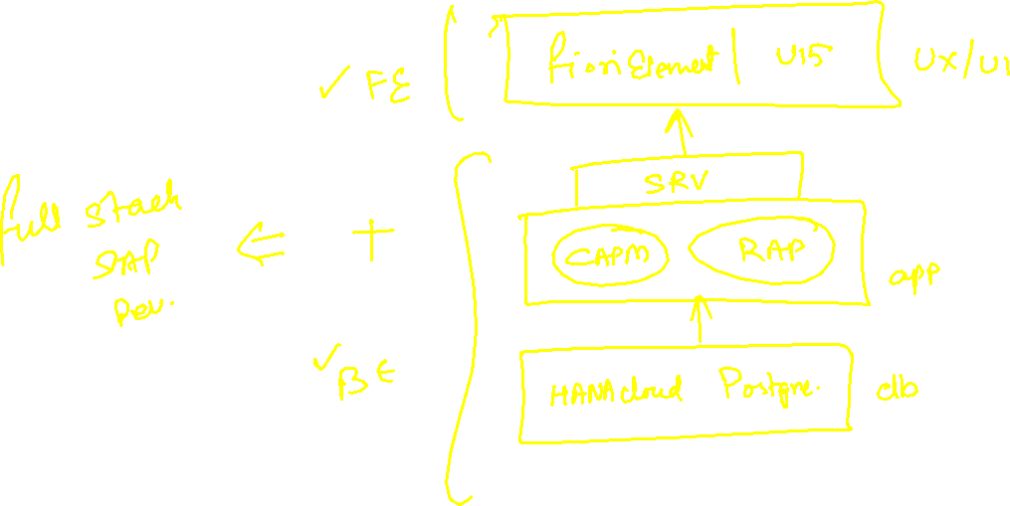
BTP Use Cases – Build New Applications

Slide 11
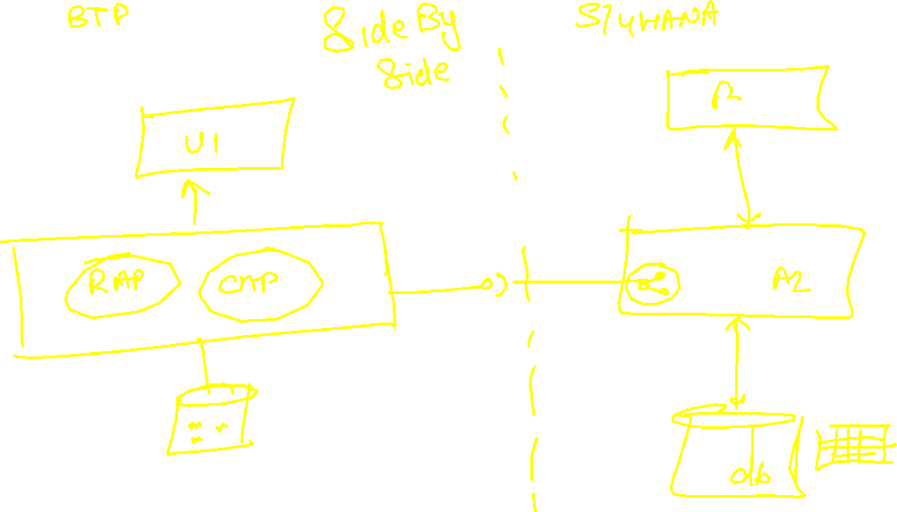
BTP Use Cases – Extend Existing Applications

Slide 12
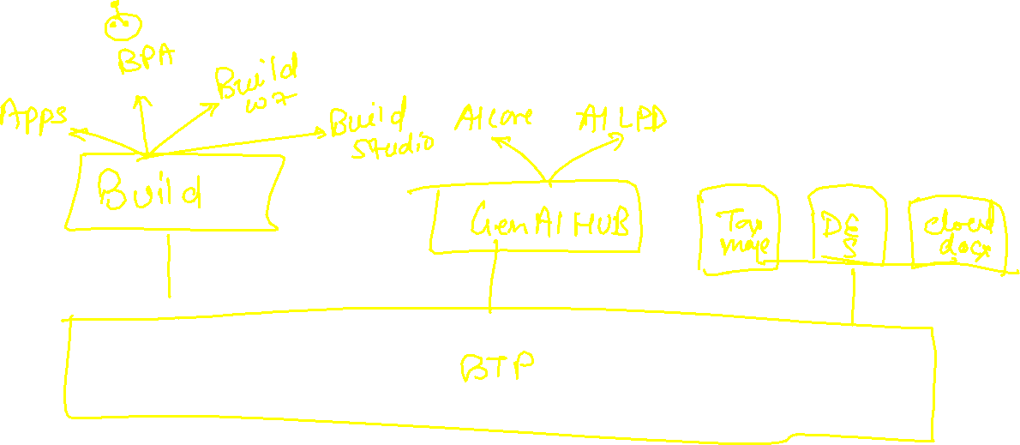
BTP Use Cases – Use intelligent Technologies

Slide 13
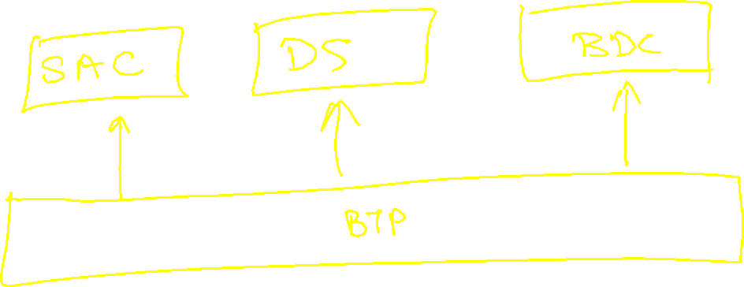
BTP Use Cases – SAP Owned Solutions

Slide 14











Tools to Setup
Git Setup - https://git-scm.com/downloads
CF CLI (Command Line Interface) Tool – allows to communicate/connect to CF
  https://github.com/cloudfoundry/cli/wiki/V6-CLI-Installation-Guide
3. Microsoft VS Code - https://code.visualstudio.com/download

Slide 15

Create First Hello World App and Deploy
https://github.com/soyuztechnologies/BTP_Architect_Training/blob/master/Day%201/helloworld.zip

Slide 16
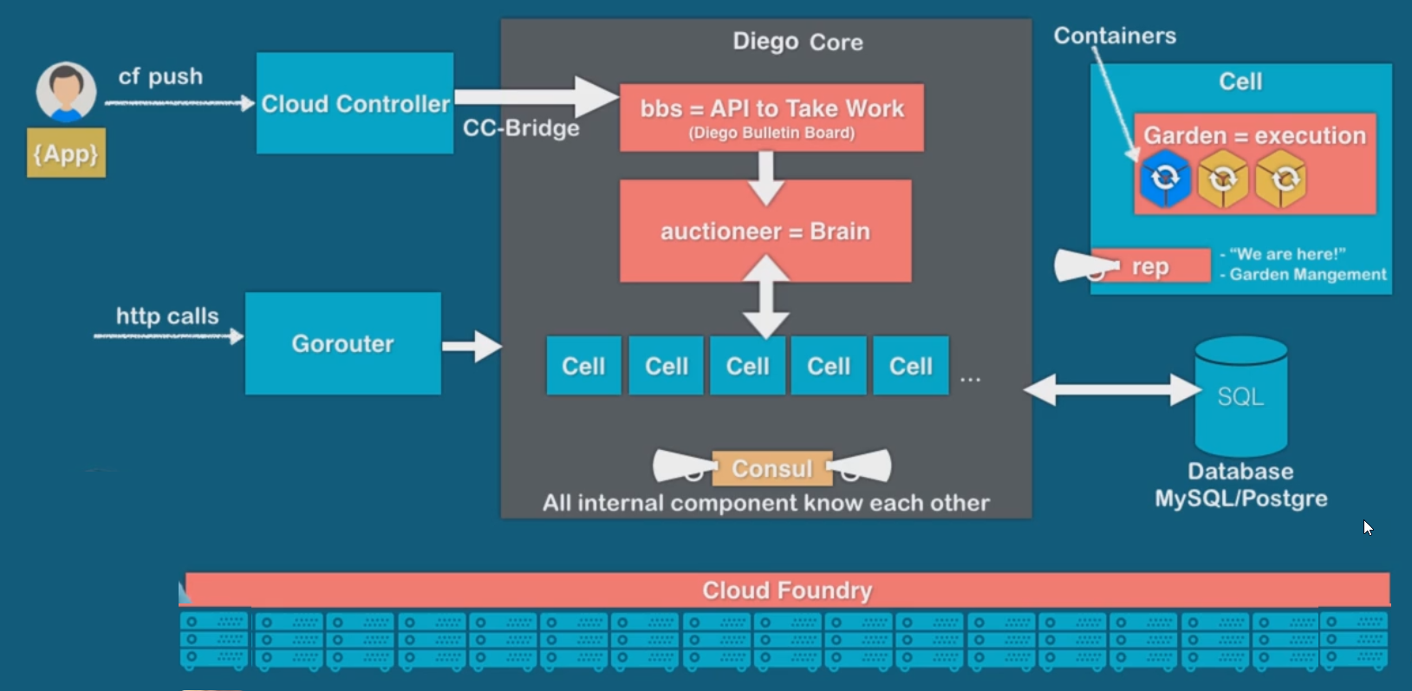
Under the hood

Slide 17
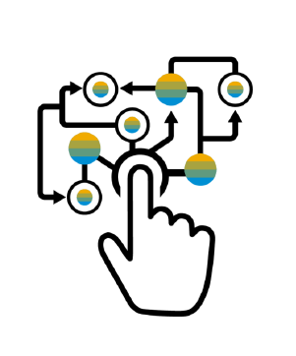
Micro Service Architecture
Characteristics of the traditional model
SAP systems are one large logical system with a single (SQL) DB
Transactional consistency for all data is guaranteed
Big, infrequent releases with high risk
Hard to apply cloud requirements
Monolith must be built, tested, deployed, and scaled as a whole
Vertical scaling* is limited, cost is non-linear
Systems often poorly utilized (dev-test, non-peak-times)
High availability setup requires almost double the infrastructure
“Microservice architecture is an approach to developing a single application as a suite of small services, each running in its own process and communicating with lightweight mechanisms, often an HTTP REST API. These services are built around business capabilities and independently deployable by fully automated deployment machinery.”

Slide 18
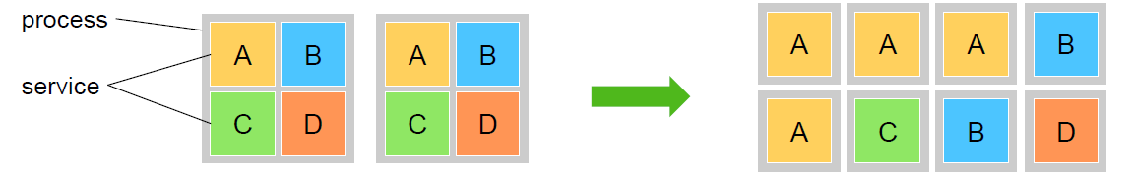
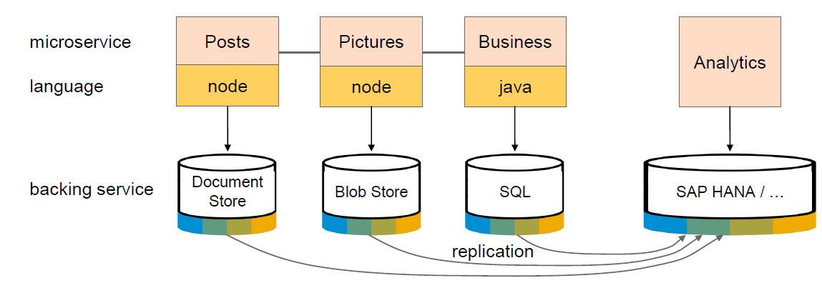
Advantage of Microservices
Each microservice runs in a separate process / container.
This enables them to
Be deployed individually and frequently
(Auto)scale independently to varying loads
You can use technologies and languages that best fit the problem *
Microservices are self-contained, i.e. no shared data stores (!)
Using the right tools impacts productivity and performance

Slide 19
Uber

Slide 20
Scalability

Slide 21
What is Node JS
Node JS is an open source, cross platform, java script runtime environment and used for executing java script code outside the web browser. Java and JavaScript are different by their nature, design and use cases. Java Script was dominantly used as a web programming language. All the browser’s directly understand java script.
Java Script
Java Script
Java
ABAP
Python
C#
Server
request
Client
Browser
port
response
Ryan Dyal
Node JS is also a great web framework for beginners because it works great with data-intensive applications like streaming, real-time apps. It is free and easy to learn node js.
Applications of node js?
Build business logic on server side, DB lookups, Send Emails, write validations, create microservices, add automations, show output, build servers, host web apps, make excel/pdf more…

Slide 22
Java Script
JS is a case-sensitive programming language e.g. iloveindia is different from iLoveIndia
Every statement in JS ends with Semi-colon
When we create a variable or function, we follow camel-case naming convention.
Iloveindia ➔ iLoveIndia wearelearningJS ➔ weAreLearningJS
If you create a variable and do not assign a value to it, it becomes NULL, any operation with NULL becomes NULL
When we create variables, we don’t need to assign data types, based on the value, the data type will be assigned automatically.
The = is an assignment operator and ==, === are comparison operator IF(a===b)
Java Script is a Asynchronous Non Blocking IO programming language

Slide 23
Variables
Scalar Variables
Array
Objects

Slide 24
NPM – Node Package manager
It is a dependency manager tool which gets installed along with node js in our system. Just like for java we had maven, we have npm for node js.
We can find millions of reusable node modules free on internet, which helps us avoid rebuilding everything/reinvent the wheel.
We can see world’s largest reusable code repository on https://npmjs.com
If we want to install any node module
Globally - @computer level, all projects can reuse, option used to install CLI.
npm install -g module
With in the project - @localproject level, only single project can use
npm install module
When we build java project, we saw a pom.xml which contains dependencies. We have the package.json file in node project which contains details about our entire project and its dependencies. To create this we use npm init command.

Slide 25
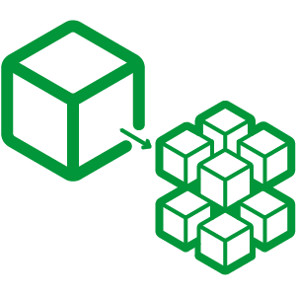

Hands on: Node JS
Solution:
https://github.com/soyuztechnologies/BTP_Architect_Training/blob/master/Day%203/02basicnode.zip
Node Microservice Solution:
https://github.com/soyuztechnologies/BTP_Architect_Training/blob/master/Day%203/03Nodemicroservice.zip

Slide 26
Variables in JS

Slide 27
Asynchronous Non Blocking IO
Application
Server

Slide 28

What We Did
Let’s Summarize

Slide 29

www.anubhavtrainings.com
Thank You
End of Day 1

Slide 30


We’re committed to empower you to be
#FutureReady
through powerful training solutions.
We build the workforce of the future.
250+
Corporate Clients
30,000+
Learners Trained
25000+
Learners Placed
FREE WEBINARS
Sign up for free webinars with industry experts every fortnight!
Enroll Now!
Contact us today!
https://anubhavtrainings.com

